Slide 1
Movie Rental Data Analysis
By: MIRZA ARSHI ABBAS

Slide 2
Project Objective
Thobjective of this project is to use MYSQL to analyse the data of a movie rental store for further growth and improve businesse

Slide 3
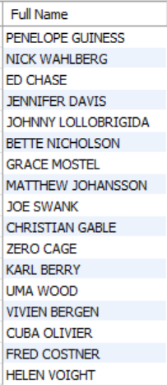
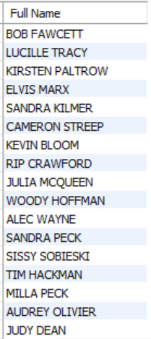
Task 1
Display full names of the actors
There are total
200
Actors

Slide 4
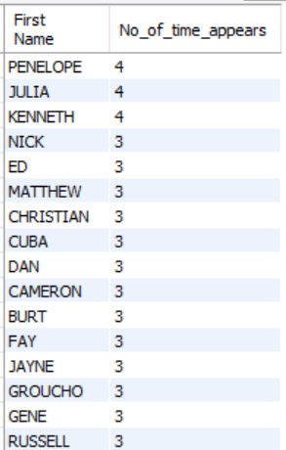
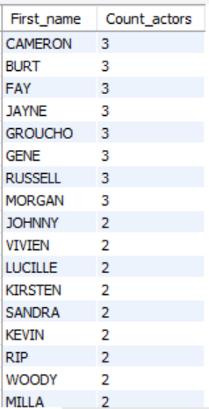
Task 2.i
First Names and occurances
Task 2.ii
First Names and Count

Slide 5
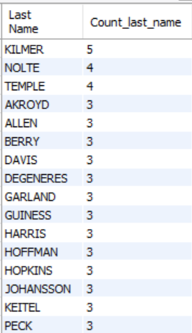
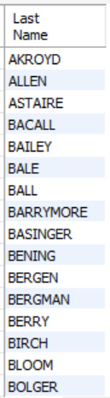
Task 3.i
Last Names and count
Task 3.ii
Distinct last name and Count

Slide 6
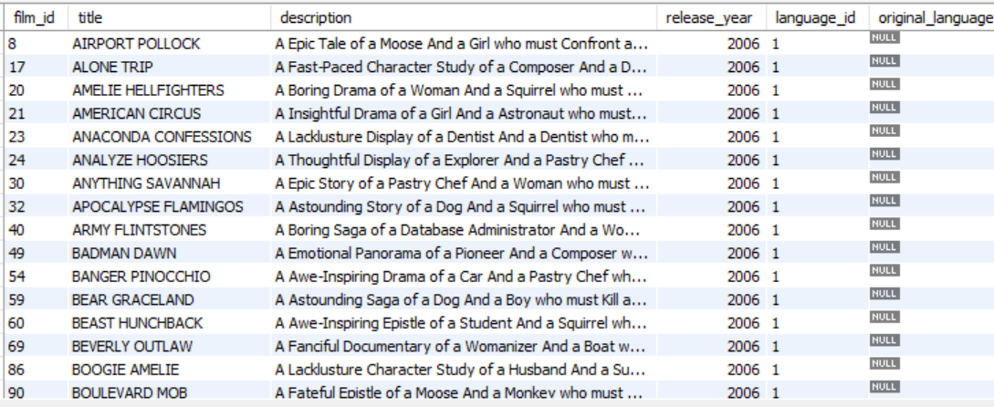
Task 4.i
List of Records where rating is R
There are total
195
Movies with rated R

Slide 7
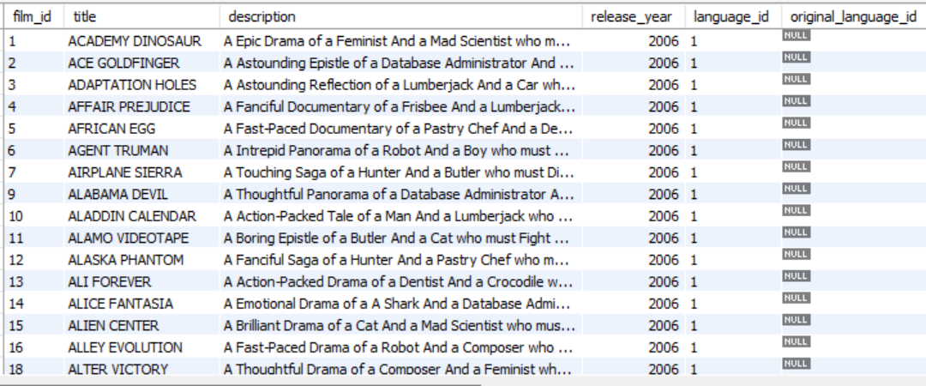
Task 4.ii
List of Records where not rating is R
There are total
805
Movies not rated R

Slide 8
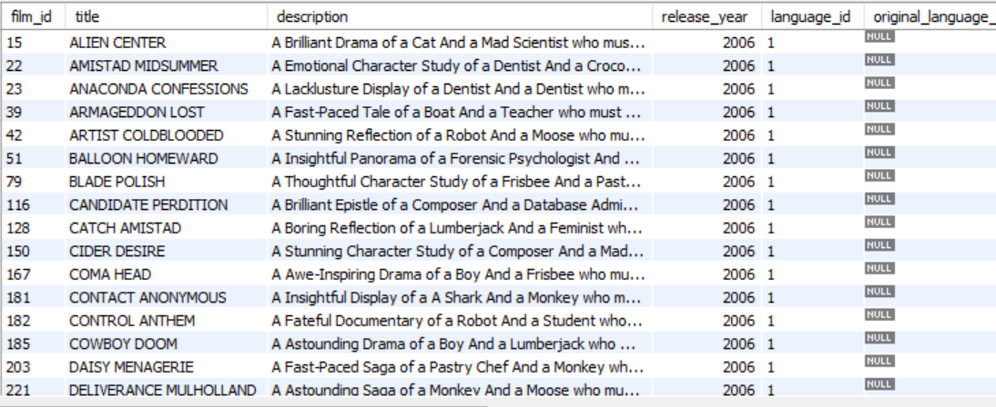
Task 5.i
Replacement cost is up to $11
There are total
90
Movies whose replacement cost is up to $11

Slide 9
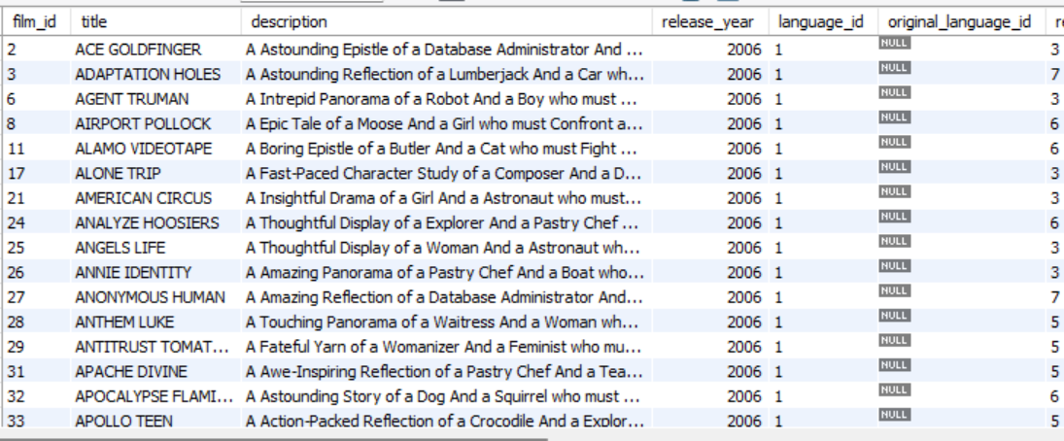
Task 5.ii
Replacement cost is between $11 & $20
There are total
424
Movies whose replacement cost is between $11 & $20

Slide 10
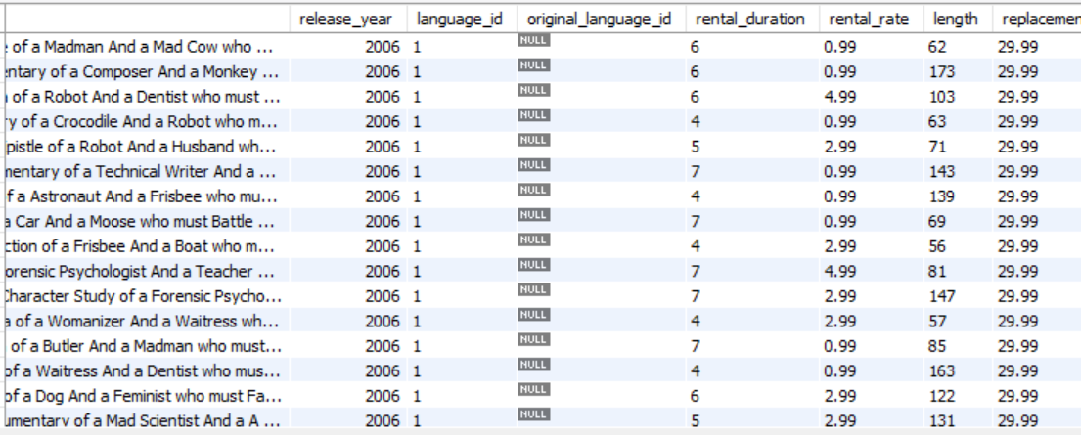
Task 5.iii
Display all the records in descending order of replacement cost
The maximum replacement cost is
$29.99

Slide 11
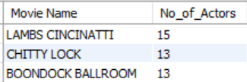
Task 6
Top 3 movies with the greatest number of actors

Slide 12
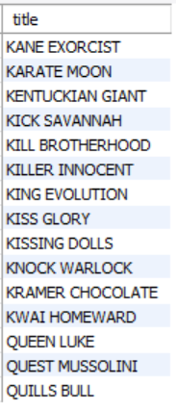
Task 7
Display the movies starting with letter K and Q
There are total
15
Movies starting with letter K and Q
12
3
Starts with K
Starts with Q

Slide 13
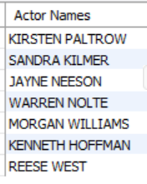
Task 8
Name of all actors working with the movie Agent Truman
There are total
7
Actors worked in Agent Truman Movie

Slide 14
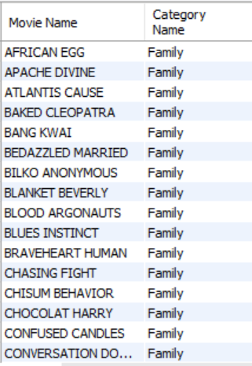
Task 9
Display all movies with family category

Slide 15
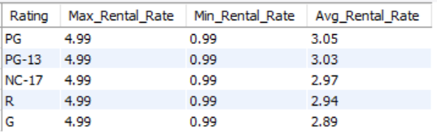
Task 10.i
Display maximum, minimum, and average rental rates based on ratings

Slide 16
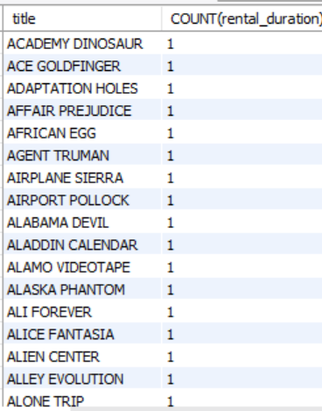
Task 10.ii
Display the movies in descending order of rental frequencies

Slide 17

Task 12
Display the film categories where no of movies > 70.

Slide 18
Thanks!
Do you have any questions?
arshonlyy@gmail.com
+91 8867 8484 50

